Slide 1

What we learnt till now!!!
Introduction to Machine Learning
Machine Learning Algorithm
Linear Regression
Logistic Regression
Decision Tree
Naïve Bayes
Practical Case Study

Slide 2
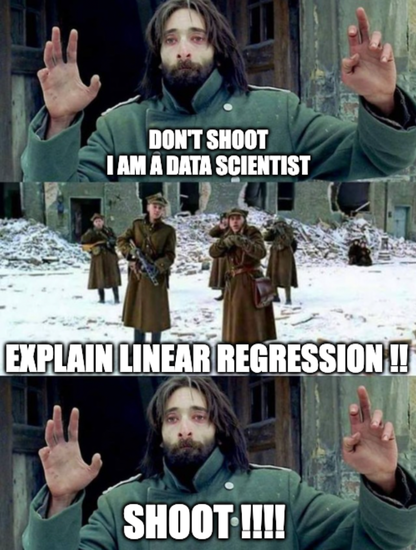
Simple Linear Regression

Slide 3

LinkedIn :- Mayank Aggarwal | LinkedIn

Slide 4
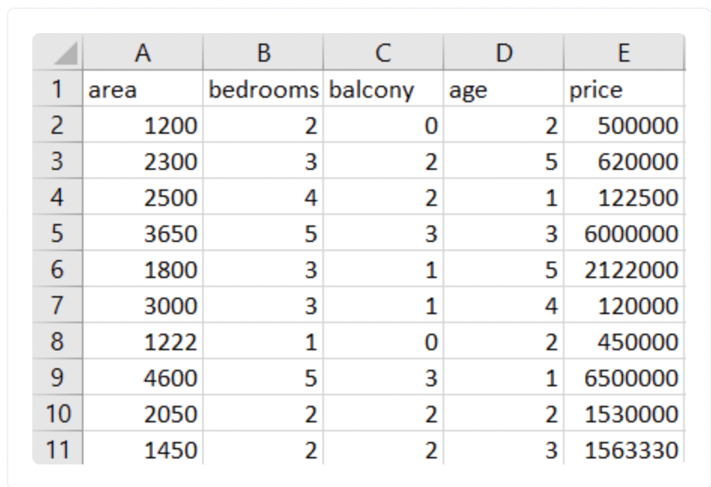
House Price Dataset
Notes:
House Price Dataset

Slide 5
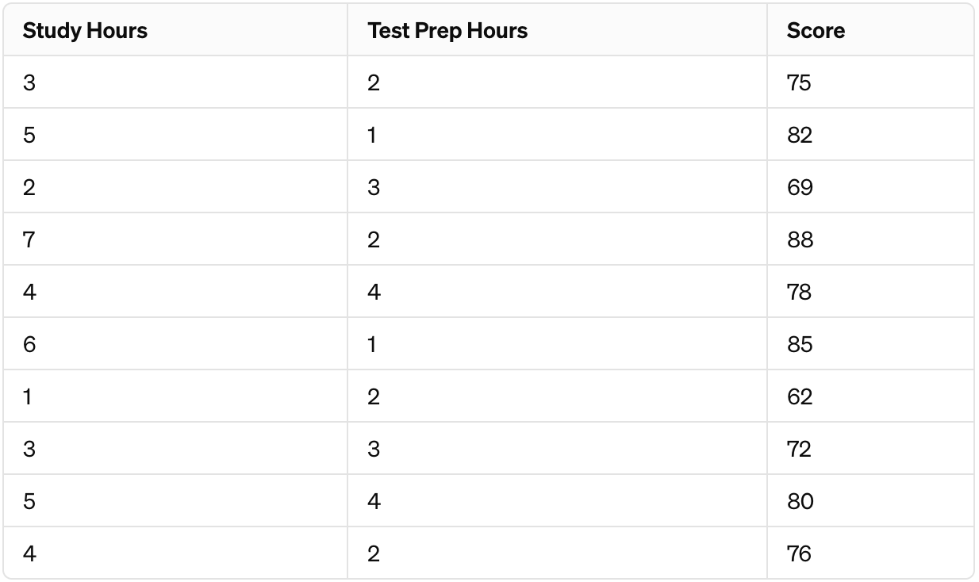
Student Score Dataset
Notes:
House Price Dataset

Slide 6
Linear Regression
It is a Prediction Model.
It is helpful in solving regression Problem.
Notes:
It’s a Prediction Model.

Slide 7
Linear Regression
It is a Prediction Model.
It is helpful in solving regression Problem.
We assume that our function is a hypothesis function which will be able to predict output when provided with new values.
We will try to find the best fit line.
Simple Linear Regression
Multiple Linear Regression
Notes:
It’s a Prediction Model.

Slide 8
Simple Linear regression
Notes:
Simple Linear regression

Slide 9
Slope , Intercept and Line Forms
Example on Jupyter Notebook
Notes:
Example on Jupyter Notebook

Slide 10
Cost Function
- We won’t be drawing a number of lines manually and then calculate the best fit line. - We need an objective way to come up with a method via which we can judge our line.
Notes:
How to actually define this error function now ?

Slide 11
Cost Function
- We won’t be drawing a number of lines manually and then calculate the best fit line. - We need an objective way to come up with a method via which we can judge our line.
How to actually define this error function now ?
Notes:
How to actually define this error function now ?

Slide 12
Cost Function

Slide 13
Coefficient of Determination
Notes:
Coefficient of Determination

Slide 14
FIN.
Ask your doubts in comments Section
Notes:
Ask your doubts in comments Section

